Slide 1

AI WELLNESS PLATFORM
AROGYA
AI-Powered Personal
Wellness Assistant
Presented by: VEERA PURNIMA VENKATA
B.Tech – Computer Science & Engineering | Pragati Engineering College
Livedemo:https://arogya9.netlify.app/

Slide 2

01 / WHY
02
The Problem I Address
😴 Daily habits
📊 Too much data
🤖 Limited guidance
Sleep, exercise and hydration are difficult to track consistently.
Users need simple insights instead of raw wellness information.
Tracking alone does not tell users what to improve next.
OUR APPROACH
One platform that turns everyday wellness data into
clear scores, recommendations and actionable next steps.

Slide 3
02 / SOLUTION
How AarogyaAI Works
01
02
03
04
05
👤
📝
📊
🎯
📈
User
Track
Analyze
Recommend
Improve
Register / Login
Enter daily wellness data
Calculate wellness score
Personalized next steps
Monitor progress over time
😴 Sleep • 🏃 Exercise • 💧 Hydration • 🥗 Nutrition • 🧘 Stress

Slide 4
03 / FEATURES
04
Core Features
🤖 AI Wellness Assistant
📊 Wellness Score
Interactive wellness guidance with AI responses and an offline fallback.
Explainable 0–100 scoring across five everyday wellness dimensions.
🎯 Personalized Recommendations
📅 Daily Tracking
Highlights weaker areas and suggests practical improvements.
Record habits and monitor wellness performance over time.
⏰ Smart Reminders
📈 Reports & Insights
Supports consistency by helping users remember healthy routines.
Turns recorded data into easy-to-understand progress information.
🔐 Secure Authentication
🚨 Safety-First AI
Registration, login and personalized user data with JWT.
Red-flag detection encourages professional help when appropriate.

Slide 5
04 / TECHNOLOGY
Technology Stack
🎨 FRONTEND
⚙️ BACKEND
🗄️ DATABASE
HTML • CSS • JavaScript
Python • Flask • REST APIs
SQLite / SQL
🤖 INTELLIGENCE
🔑 SECURITY
🚀 DEPLOYMENT
AI Assistant • Scoring • Recommendations • Safety Detection
JWT Authentication
Gunicorn • Netlify

Slide 6
05 / ARCHITECTURE
06
System Workflow
👤
📝
🧠
💡
📈
🤖
User
→
Input
→
Engine
→
Output
→
Dashboard
→
Assistant
Login / Register
Daily wellness data
Score + analysis
Recommendations
Reports + progress
Wellness conversation
🚨 Safety Layer: Red-Flag Detection → Appropriate Safety Guidance

Slide 7
06 / IMPACT
07
Future Scope & Conclusion
📱 Mobile App
🎯 Conclusion
Android / iOS experience for daily wellness tracking.
AarogyaAI makes everyday wellness tracking simple, personalized and accessible.
🌱 Track → Analyze → Recommend → Improve
The goal is to encourage healthier, more consistent habits through understandable, data-driven wellness insights.
⌚ Wearable Integration
Connect smartwatch and fitness-tracker data.
🗣️ Voice + Languages
Voice assistant and multilingual Indian-language support.
🚀 LIVE DEMO • arogya9.netlify.app

Slide 8
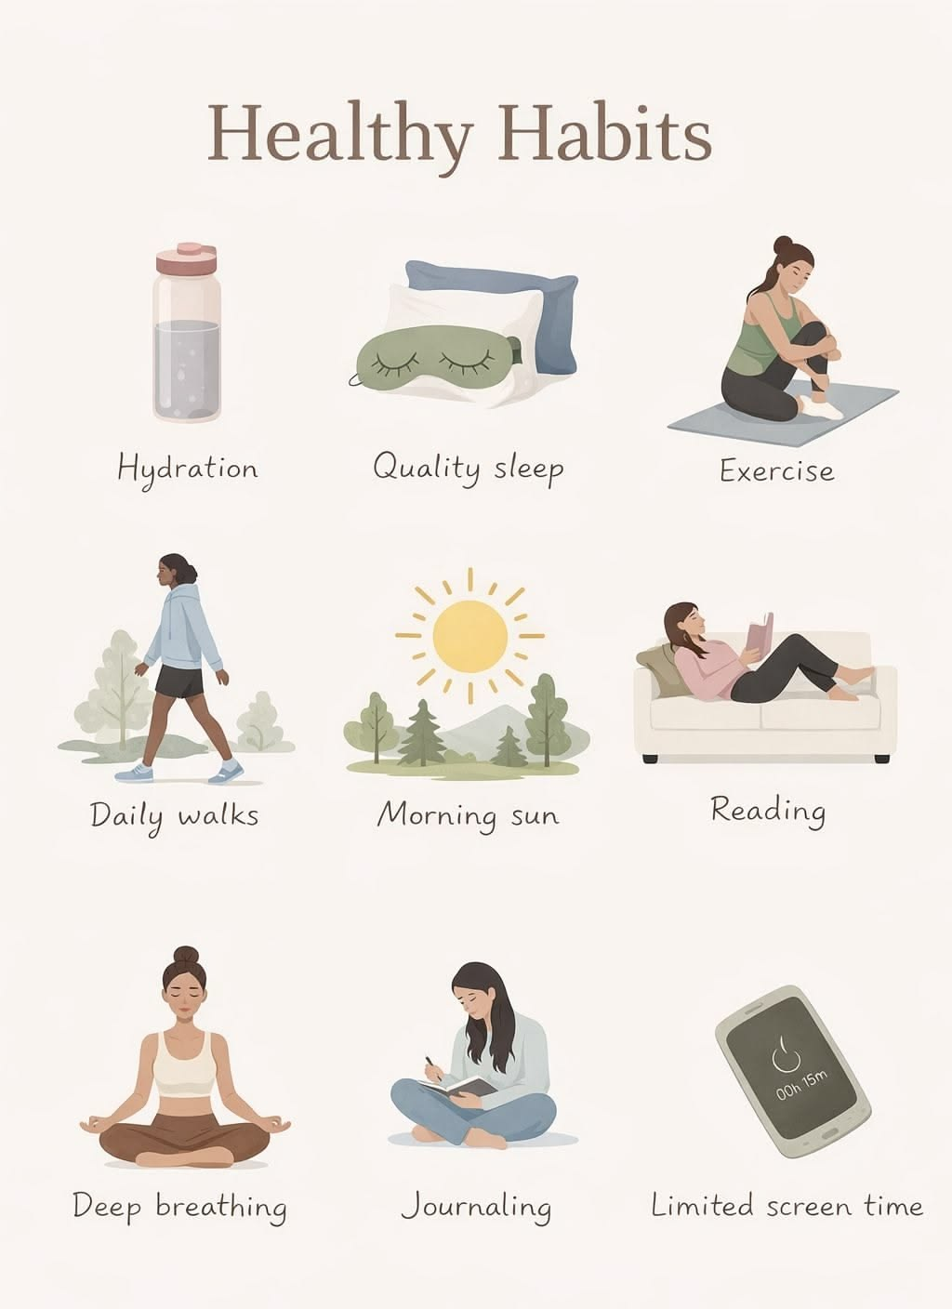
Thank You

